Slide 1

UIDAI Hackathon 2021
Team Reference ID : qsgaTZtvLo
Team Name: Elite_Squad
Team Member Details
S.No | Name | E Mail ID
1. | Aayushi | aayushi20csu142@ncuindia.edu
2. | Neha | neha20csu149@ncuindia.edu
3. | Shubham (Team Leader) | shubham20csu158@ncuindia.edu

Slide 2
Problem Statement :
Theme: Address Update
Problem Statement: Address Formatting Issue.
Imagine you belong to the capital city of India and you reside within IIT Delhi campus. You have just enrolled yourself to the Aadhar identity platform and after successful enrolment, you have received your letter containing the Aadhar number, demographics data such as name and address. Alas, in the address field you see the repetition of ‘Delhi’ multiple times, making the address a little convoluted. Like you, many of the residents especially those who are residing in the urban areas see the repetition of the same content in the final address.

Slide 3
Problem Statement (Contd..)
4.1 You have to devise an innovative solution to identify repetitive content (like Delhi in the instant use case) and merge it in a manner that the overall address remains intact and usable. The solution must comply with the following:-
4.1.1 Essential fields like District and State can be merged into a single entity.
4.1.2 If the repetitive text is a subpart of a field, then merger should be avoided. For example, ‘Purani Delhi’ as locality and ‘Delhi’ as State can’t be merged.
4.1.3 An API is to be developed which will take the address in its raw form as input and optimized/formatted response should be the output. No user interface would be required.
4.1.4 Bonus credit would be given to the team who can also consider the address in the local language and optimize the same.
4.1.5 You can use any open-source technologies to demonstrate the solution.

Slide 4
Packages and classes :
We have made two java file, one servlet file and one jsp file for this project.
Package name: uidai
Java file name:
UserInput.java
UserDatabase.java
Servlet file name: UserResult.java
JSP file name: RegistrationUser.jsp

Slide 5
Approach
We have asked user to enter the required address field in client view.
It will send request to the servlet which will apply validations check on all values and perform address formatting.
For address formatting, we have used linkedHashSet as it takes only unique value and maintains the insertion order.
After address formatting, data is stored in the database.
Formatted address is displayed to the client side.

Slide 6
Architectural Diagram
Client-page
(User input)
Servlet
(Validates and sends values to database)
Database
(creates table, stores values in it and execute the required query)
Request
Request
Response
Client-page
(Displays the result)
JSP
(It takes response from the servlet)
Response

Slide 7
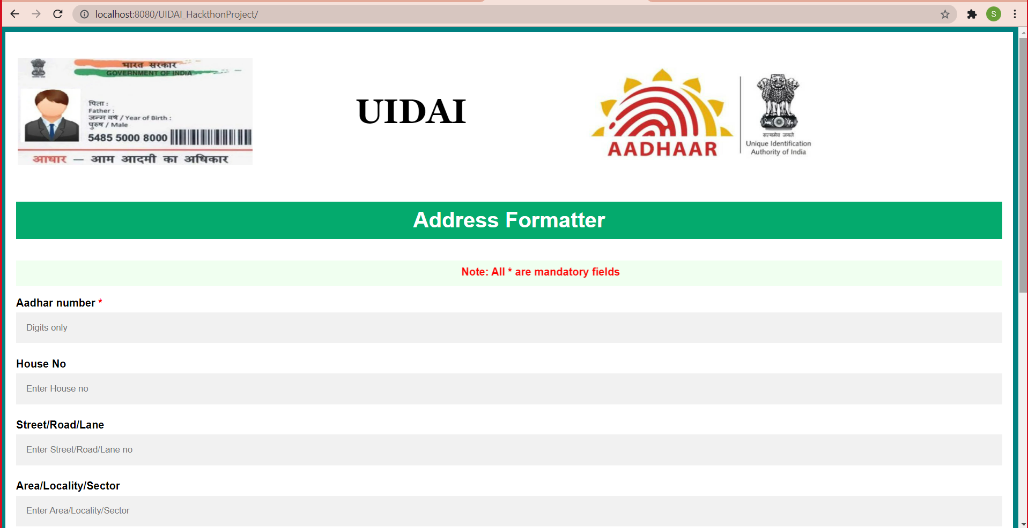
Output Snapshot:
Client view page

Slide 8
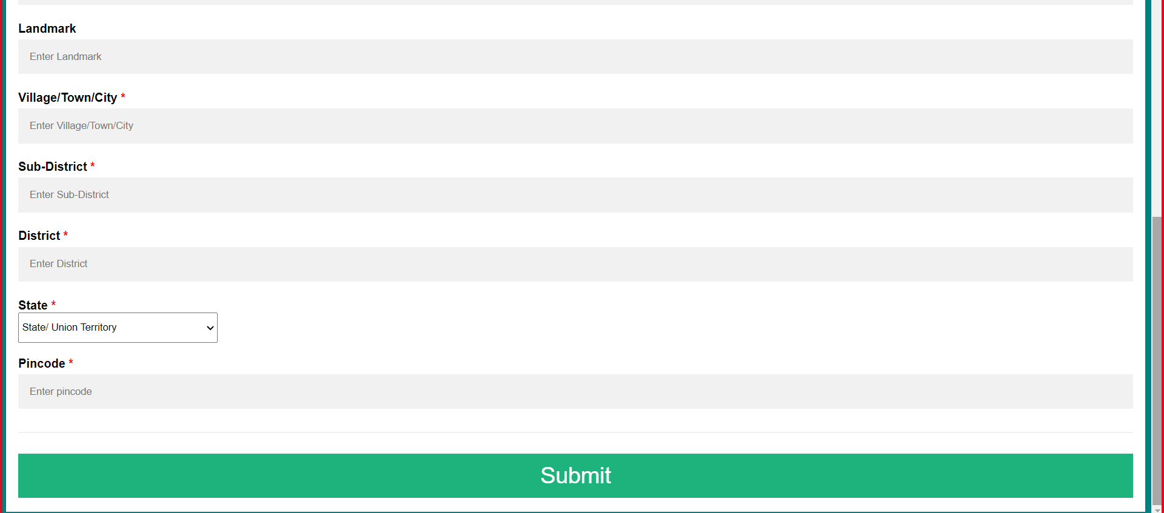
Output Snapshot:
Client view page (contd..)

Slide 9
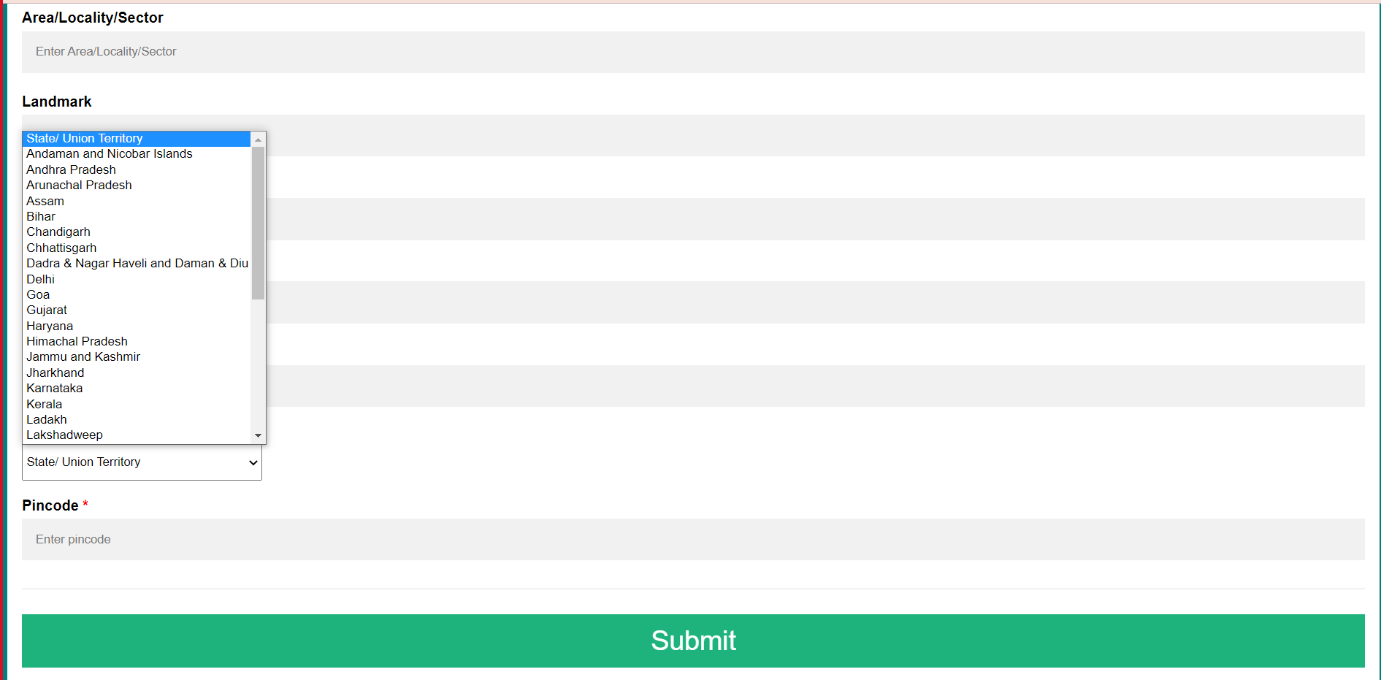
Output Snapshot:
Client view page (Contd..)

Slide 10
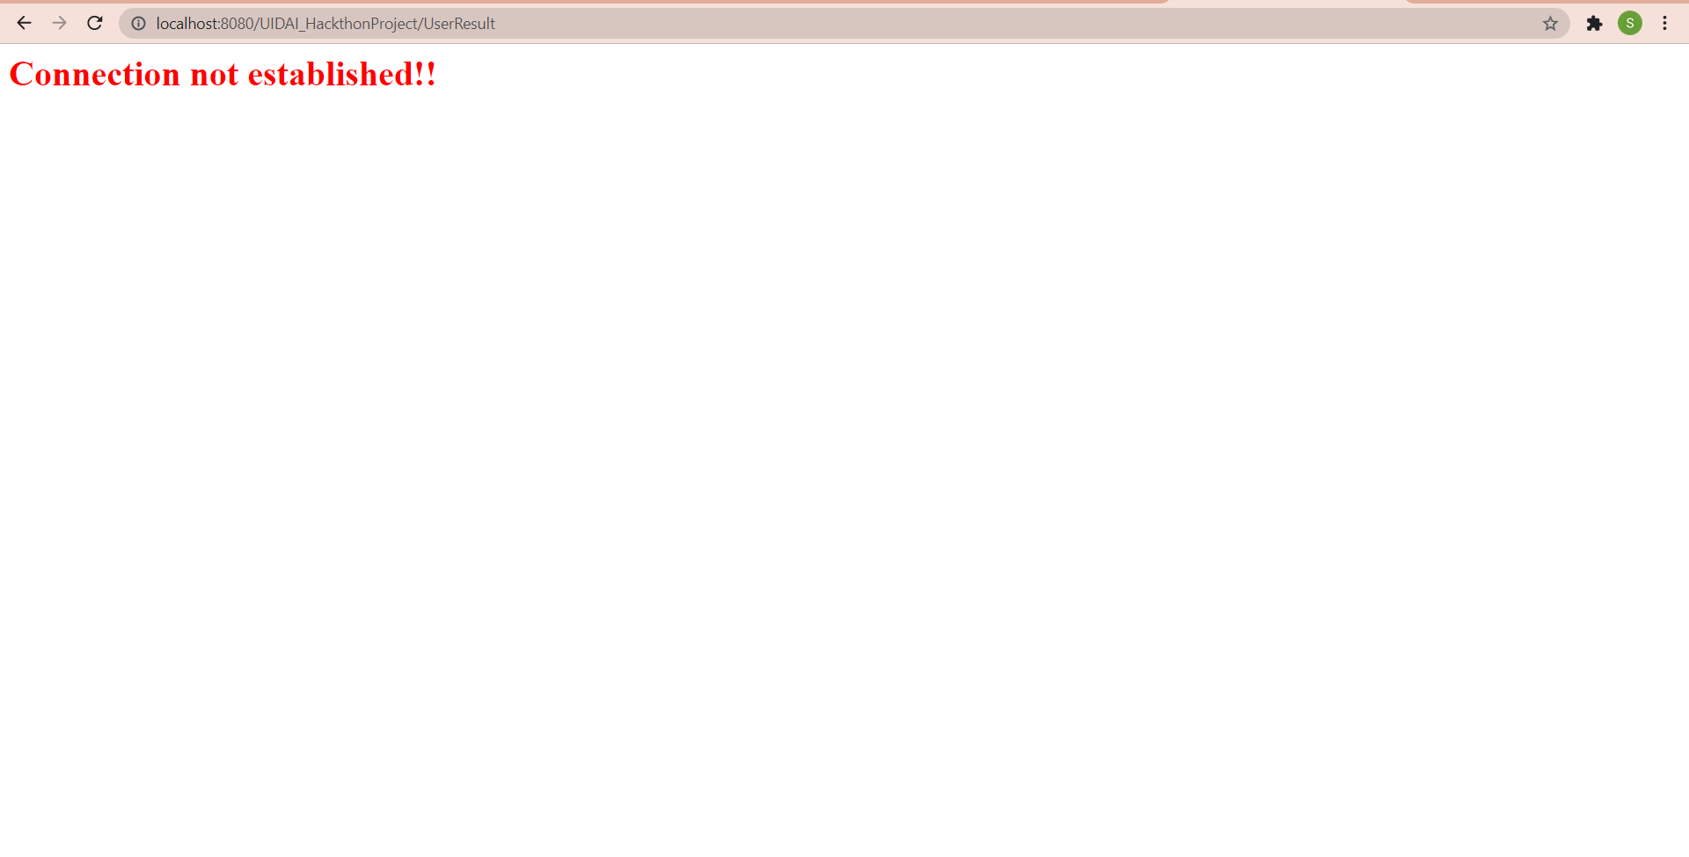
Output Snapshot:
Case 1: When connection might not be established-

Slide 11
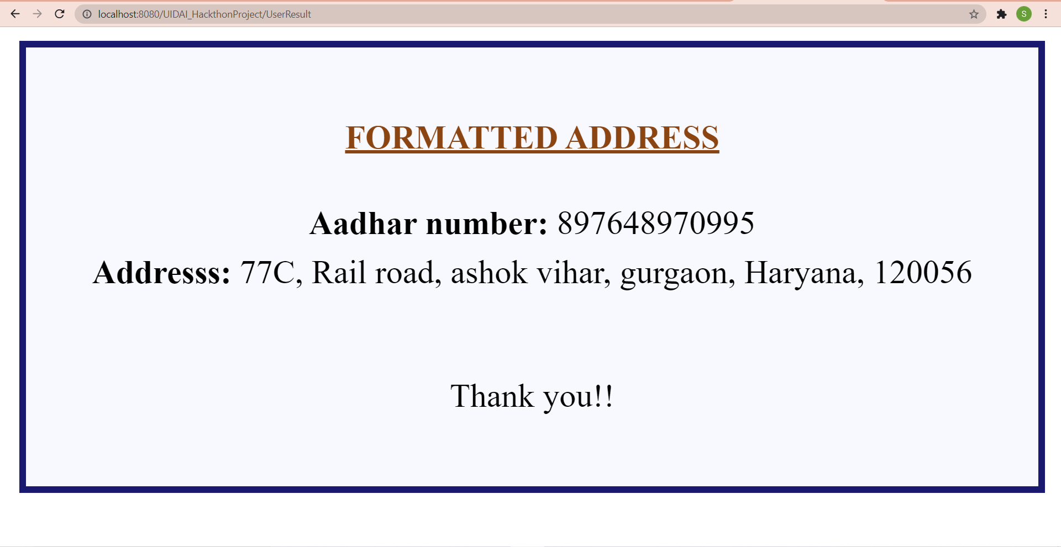
Output Snapshot:
Case 2: When all validation check are correct -

Slide 12
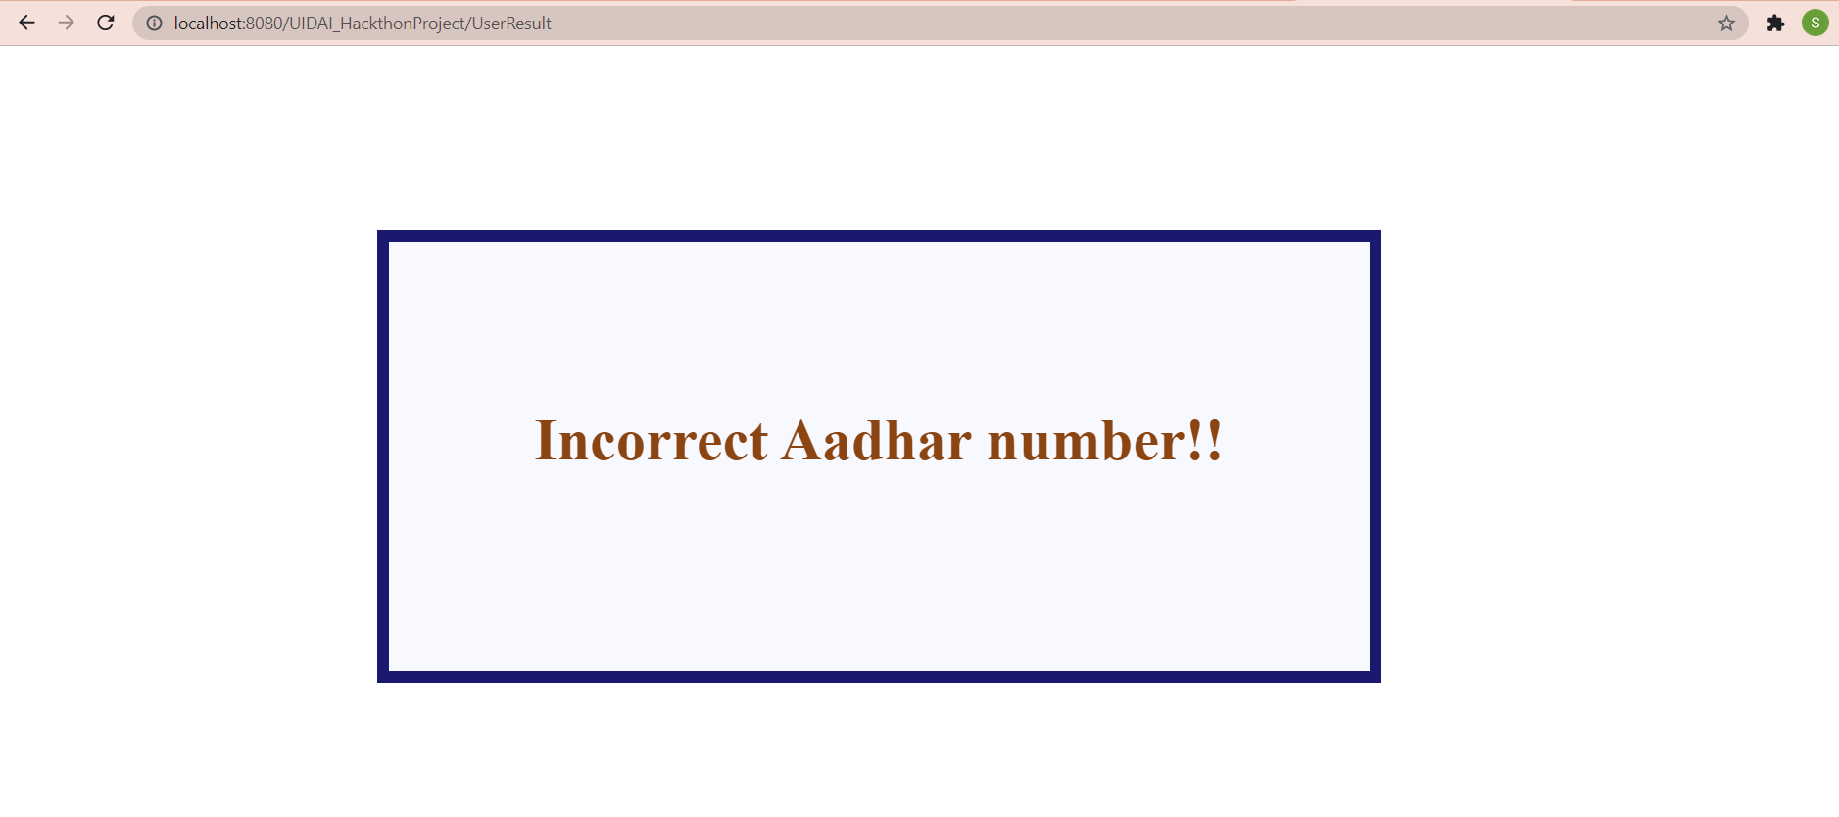
Output Snapshot:
Case 3: When user enters Aadhaar number other than digit -

Slide 13
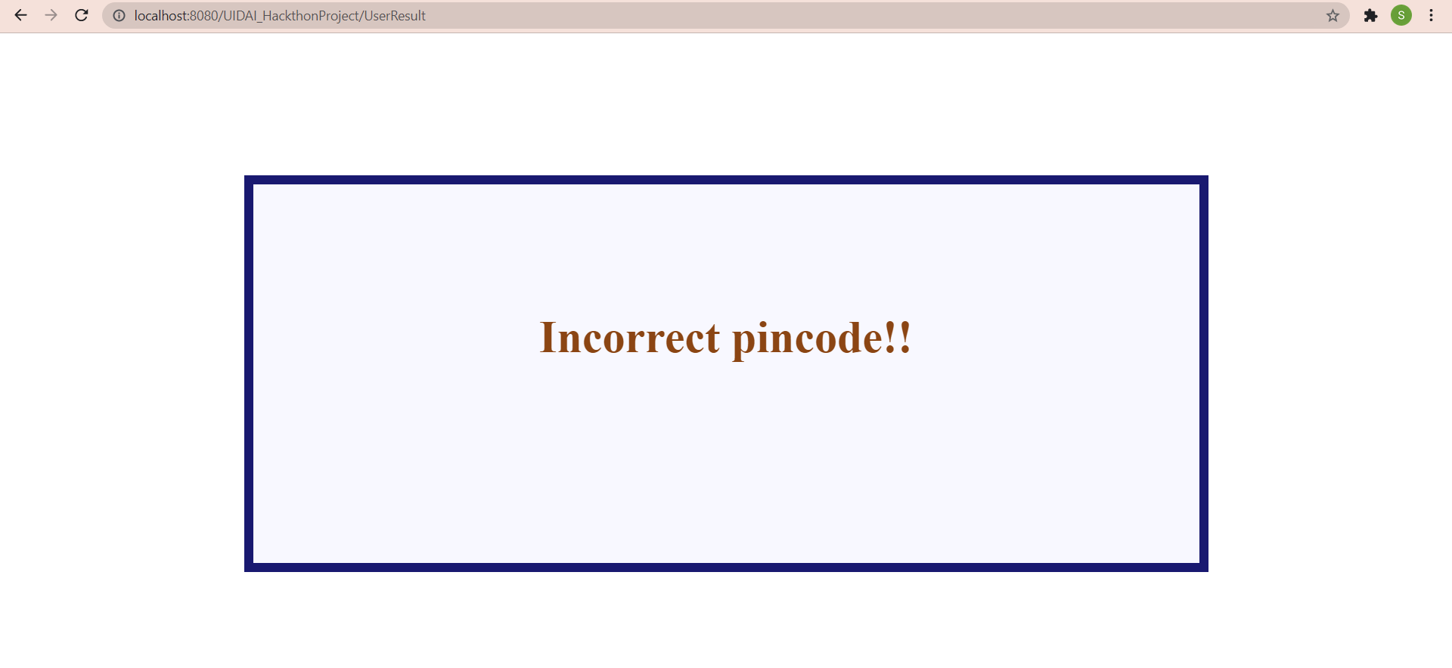
Output Snapshot:
Case 4: When user enters pincode other than digit -

Slide 14
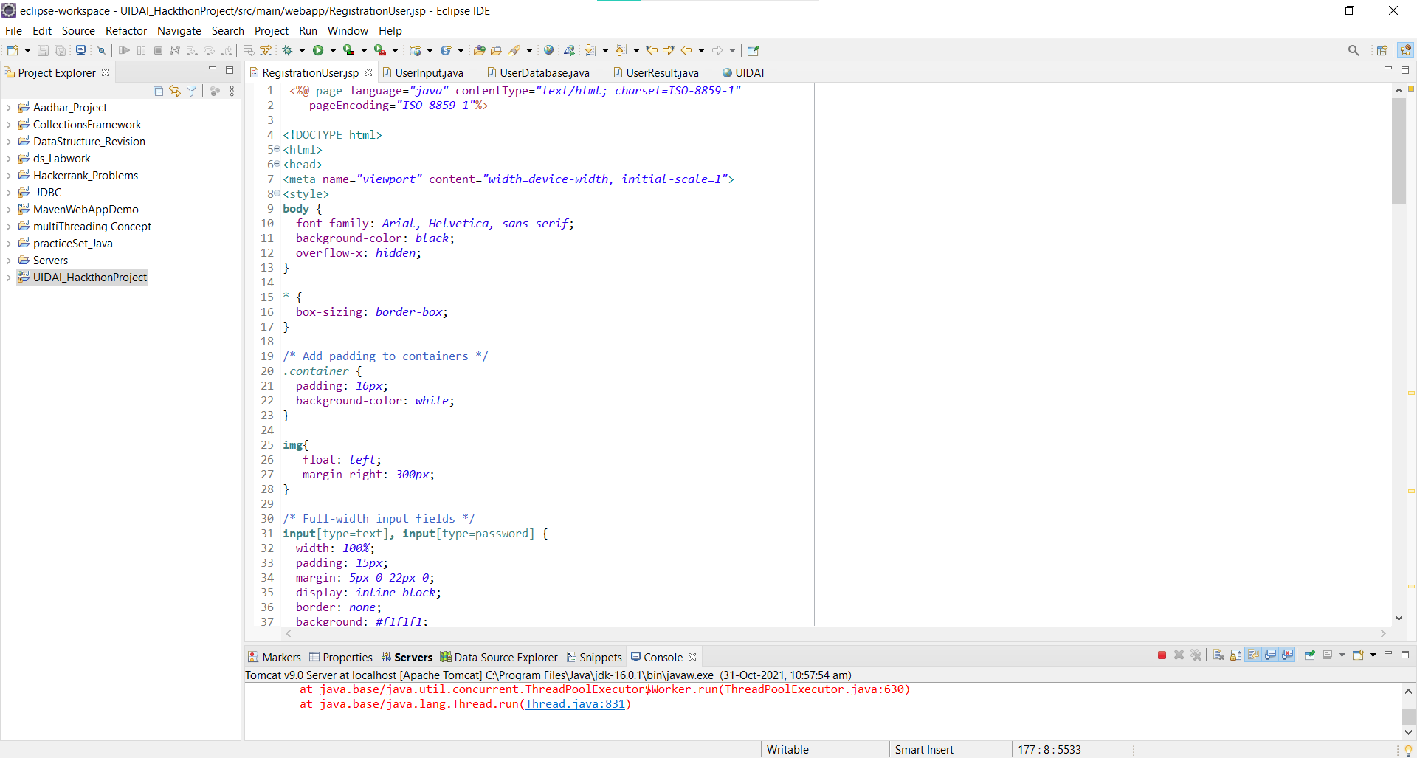
Eclipse workspace Snapshot:

Slide 15
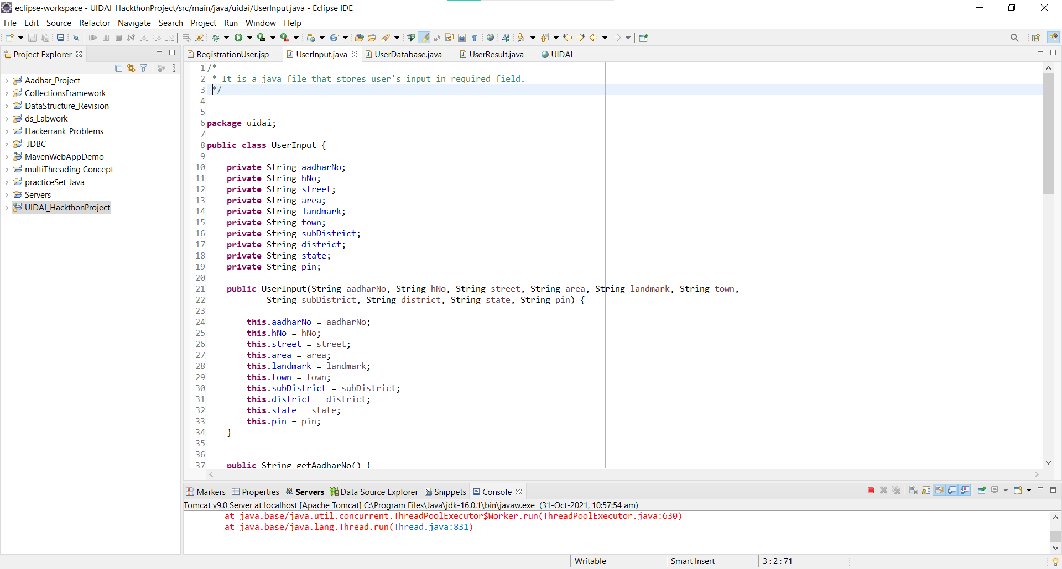
Eclipse workspace Snapshot:

Slide 16
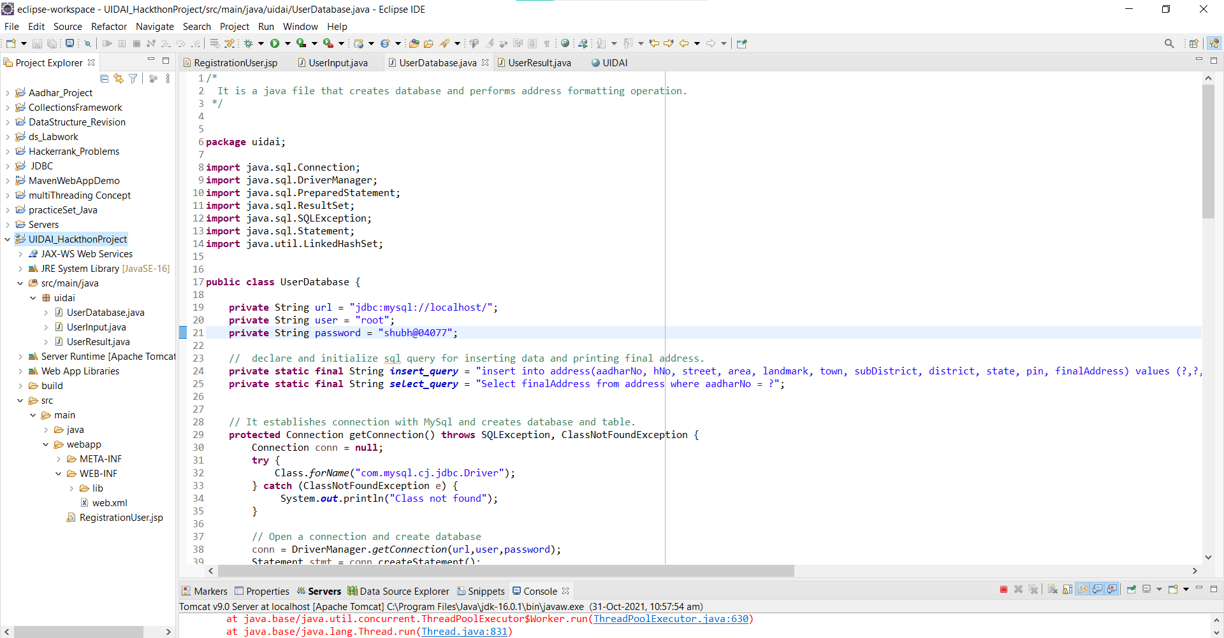
Eclipse workspace Snapshot:

Slide 17
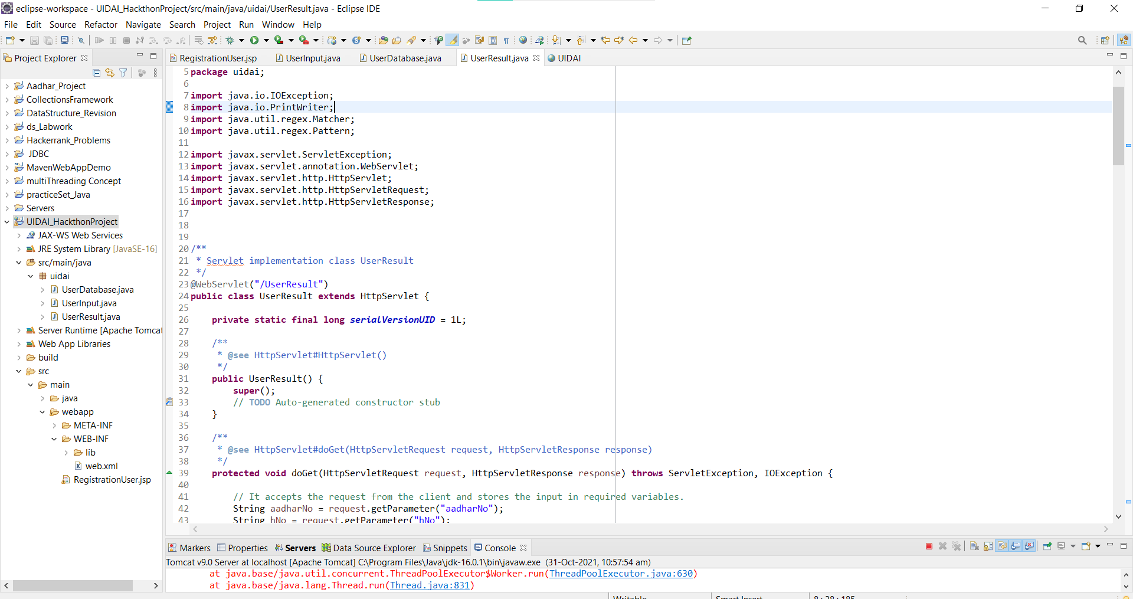
Eclipse workspace Snapshot:

Slide 18
API Usage
We have used java servlet api and jdbc along with database MySQL.
We have used dependencies mentioned below:-
mysql-connector-java-8.0.25 jar
Jstl-1.2 jar
Jsp-api-2.2.jar
Servlet-api-2.5
We have used “Apache tomcat version 9.0” as a local server.

Slide 19
Security Consideration:
We have used local server in our project.
This is our project URL in local system.
http://localhost:8080/UIDAI_HackthonProject
http://localhost:8080/UIDAI_HackthonProject/UserResult

Slide 20


